Slide 1

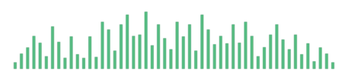

Slide 2
Sound Overview

Slide 3
My Daily Rhythm

Slide 4
My Listening DNA

Slide 5
My Artists

Slide 6
Platforms & Context

